Slide 1
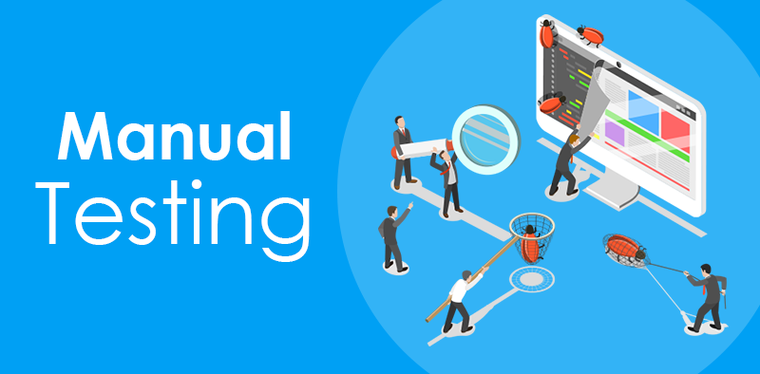
Vamsi.K

Slide 2
Manual Testing Concepts
Introduction
SDLC Phases
Models of SDLC
Levels of Testing
Testing Terminology
Software Testing Techniques
Software Testing Life Cycle
Defect Life Cycle
Agile Scrum Framework
Jira
Roles and Responsibilities

Slide 3
Introduction
SDLC, Software development life cycle is a process used by software industry to design ,develop and test the quality software
The main aims to produce high quality software meets the customer expectations
It is also called as Software development process
SDLC is a framework defining the tasks performed at each step in the software development process

Slide 4
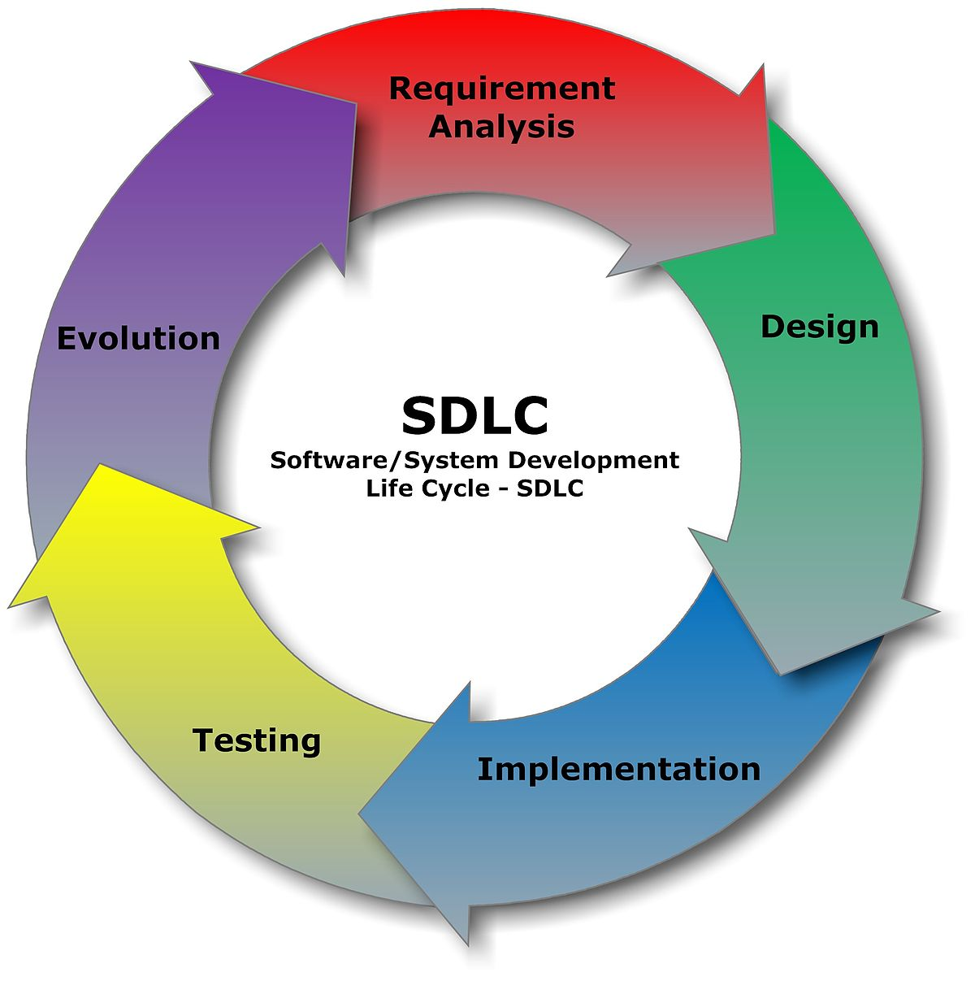
SDLC Phases
Requirements
Analysis
Design
Coding
Testing
Release and Maintenance

Slide 5
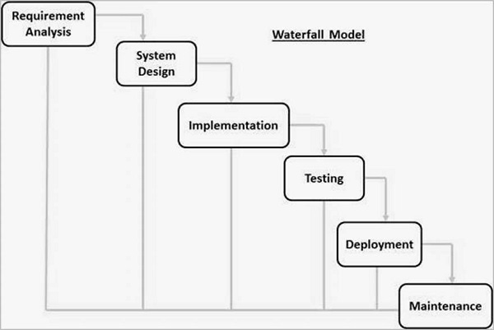
Models of SDLC
Water Fall Method

Slide 6
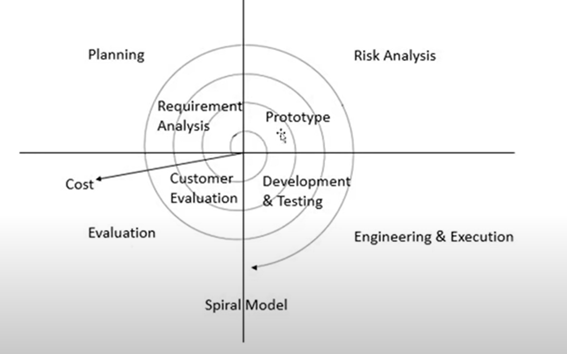
Spiral Model

Slide 7
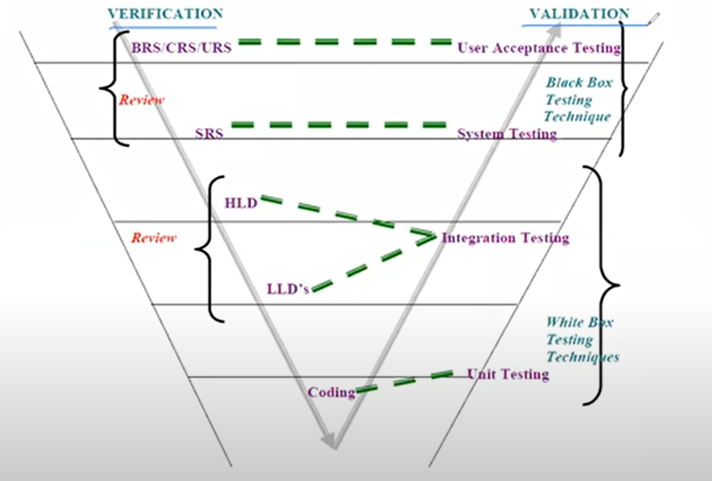
VV Model

Slide 8
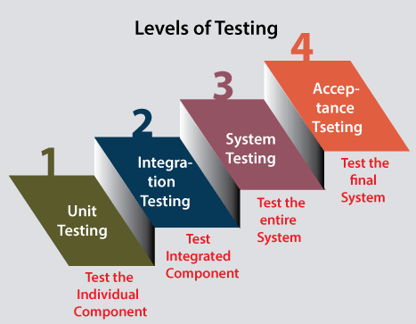
Levels of Testing

Slide 9
Unit Testing
Testing the single module of our software developer himself conduct testing because they know the coding part, they know how written the code so they how module is working.
It will comes under White box testing

Slide 10
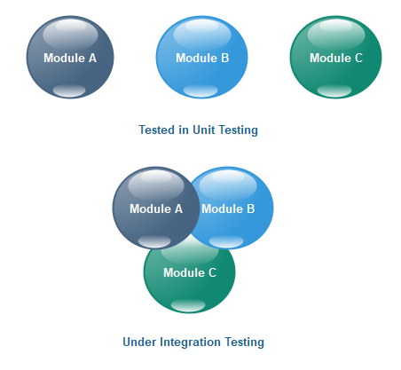
Integration Testing
Integration testing is performed between 2 or more modules
Integration testing focusses on checking the data communication between multiple modules
Output of one module is input of next module
There are 2 types of integration testing
a)Top Down Approach
b)Bottom Up Approach

Slide 11
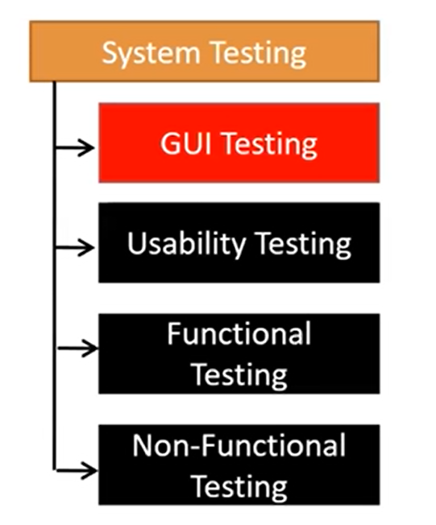
System Testing

Slide 12
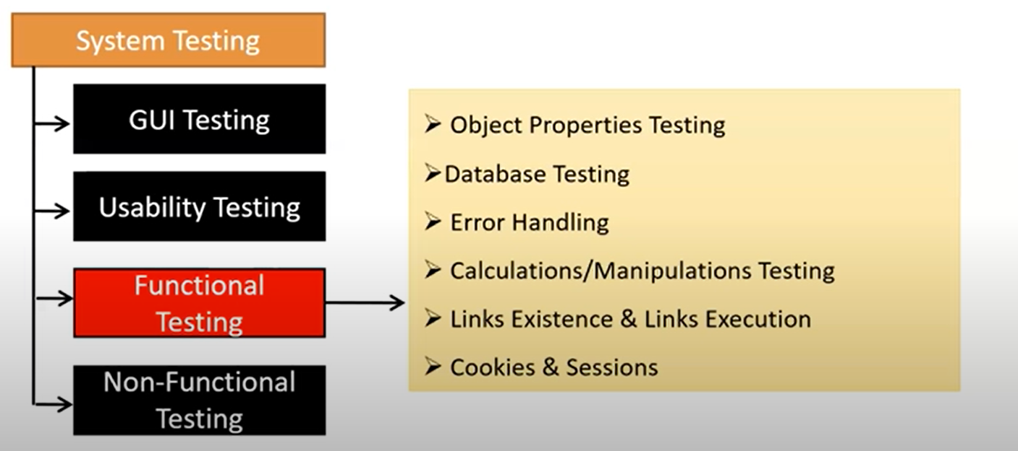
Functional Testing

Slide 13
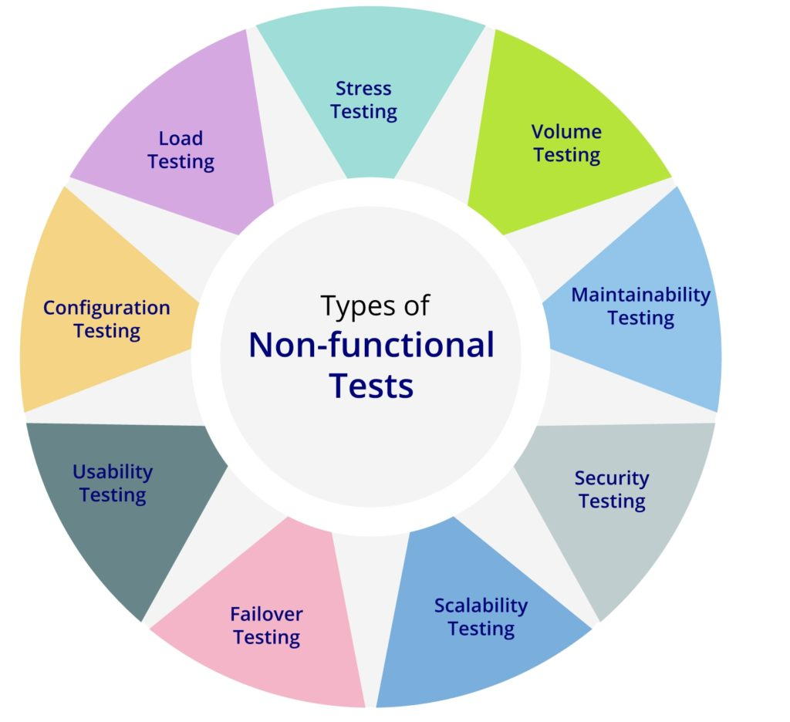
Non-Functional Testing

Slide 14
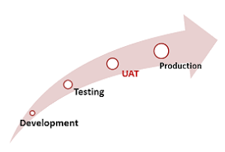
User Acceptance Testing
UAT Testing: (UAT) is a type of testing performed by the end user or the client to verify/accept the software system before moving the software application to the production environment. UAT is done in the final phase of testing after functional, integration and system testing is done.
It is done by UAT Testers who represents the client premises
UAT has 2 types of testing.
a)Alpha Testing
b)Beta Testing
a)Alpha Testing: Alpha Testing is done by functional testers in the UAT environment in the premises of Product based company
b)Beta Testing: Beta testing is done by UAT Testers in UAT environment
Beta Testing is performed by clients or users who are not employees of the company

Slide 15
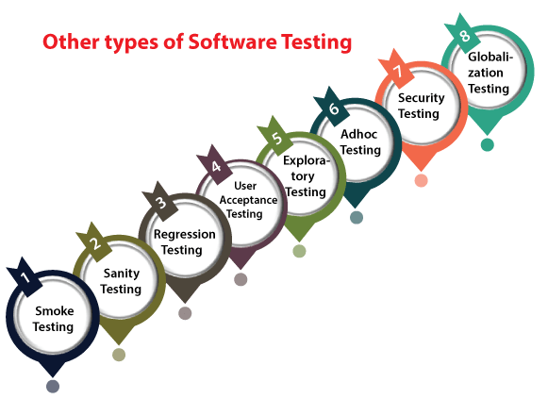
Testing Terminology

Slide 16
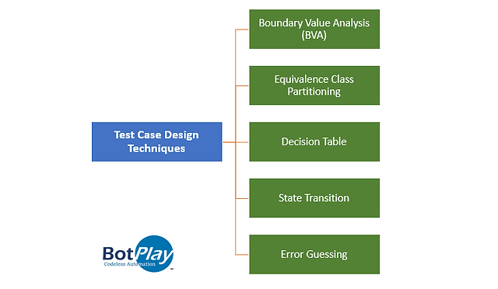
Test Design Techniques

Slide 17
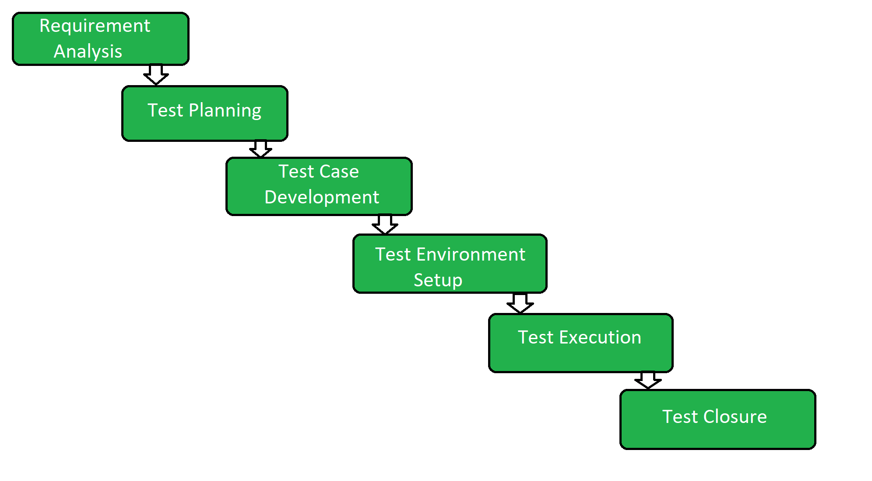
Software Testing Life Cycle

Slide 18
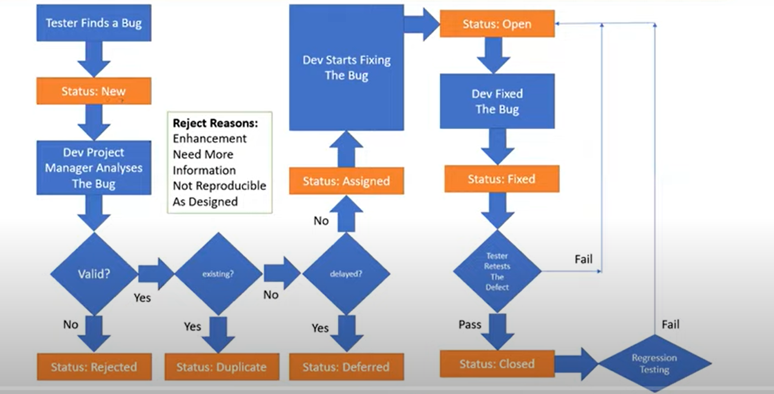
Defect Life Cycle

Slide 19
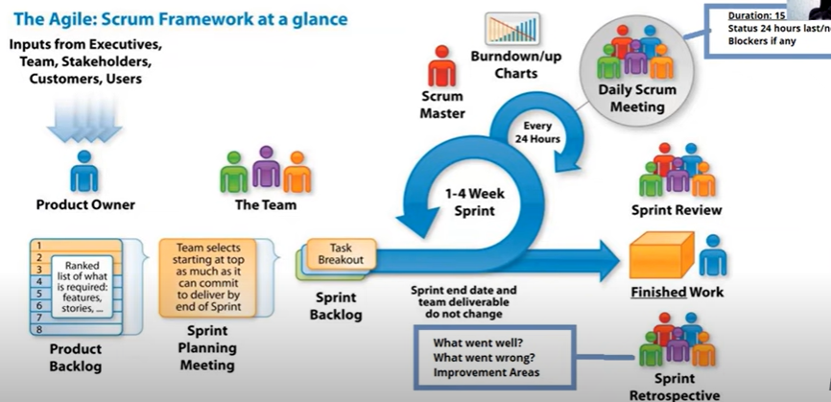
Agile Scrum Framework

Slide 20

JIRA-Agile Management TOOL
Cloud Assistance
Free Version:10 days
Link: www.atlassin.com/software/jira/free
Agile scrum activities
How to create a project in a Jira
How to add users in Jira
How to create a Backlog-Epic
How to create Jira and story points
Creating sprint in Jira
Adding user stories to sprint
Adding sub task to the story
Sprint Life cycle

Slide 21

Test Management Activities(zephyr)
Test Cases
Test Cycles
Updated test cases passed/failed/blocked
Report Bugs
Reports
How to install zephyr plugin
How to create test cases in Jira manually
How to create multiple test cases in Jira tool
Create test cycles
Add test cases to the cycle
Execute and update test cases
Reporting bugs
Reports in zephyr
Traceability Matrix

Slide 22
Roles and Responsibilities
Understanding the requirements and functional specifications
Identifying required test scenarios
Designing test cases to validate application
Setting up test environment(Test Bed)
Execute test cases to validate application
Log test results(How many test cases pass/fail)
Defect reporting and tracking
Retest fixed defects of previous build
Perform various types of testing's in application
Reports to test lead about the status of assigned tasks
Participated in the regular meetings
Provides recommendation on whether or not application is ready for production

Slide 23

Thank You

